Slide 1
Chapter 1: Introduction
DBMS

Slide 2
Chapter 1: Introduction
■
Purpose of Database Systems
■
View of Data
■
Database Languages
■
Relational Databases
■
Database Design
■
Object-based and semistructured databases
■
Data Storage and Querying
■
Transaction Management
■
Database Architecture
■
Database Users and Administrators
■
Overall Structure
■
History of Database Systems
DBMS

Slide 3
Database Management System (DBMS)
■
DBMS contains information about a particular enterprise
●
Collection of interrelated data
●
Set of programs to access the data
●
An environment that is both convenient and efficient to use
■
Database Applications:
●
Banking: all transactions
●
Airlines: reservations, schedules
●
Universities: registration, grades
●
Sales: customers, products, purchases
●
Online retailers: order tracking, customized recommendations
●
Manufacturing: production, inventory, orders, supply chain
●
Human resources: employee records, salaries, tax deductions
■
Databases touch all aspects of our lives

Slide 4
Purpose of Database Systems
■
In the early days, database applications were built directly on top of
file systems
■
Drawbacks of using file systems to store data:
●
Data redundancy and inconsistency
 Multiple file formats, duplication of information in different files
●
Difficulty in accessing data
 Need to write a new program to carry out each new task
●
Data isolation — multiple files and formats
●
Integrity problems
 Integrity constraints (e.g. account balance > 0) become “buried” in program code rather than being stated explicitly
 Hard to add new constraints or change existing ones
DBMS

Slide 5
Purpose of Database Systems (Cont.)
■
Drawbacks of using file systems (cont.)
●
Atomicity of updates
 Failures may leave database in an inconsistent state with partial updates carried out
 Example: Transfer of funds from one account to another should either complete or not happen at all
●
Concurrent access by multiple users
 Concurrent accessed needed for performance
 Uncontrolled concurrent accesses can lead to inconsistencies
– Example: Two people reading a balance and updating it at the same time
●
Security problems
 Hard to provide user access to some, but not all, data
■
Database systems offer solutions to all the above problems
DBMS

Slide 6
Levels of Abstraction
■
Physical level: describes how a record (e.g., customer) is stored.
■
Logical level: describes data stored in database, and the relationships
among the data.
type customer = record
customer_id : string; customer_name : string; customer_street : string; customer_city : integer;
end;
■
View level: application programs hide details of data types. Views can
also hide information (such as an employee’s salary) for security purposes.
DBMS

Slide 7
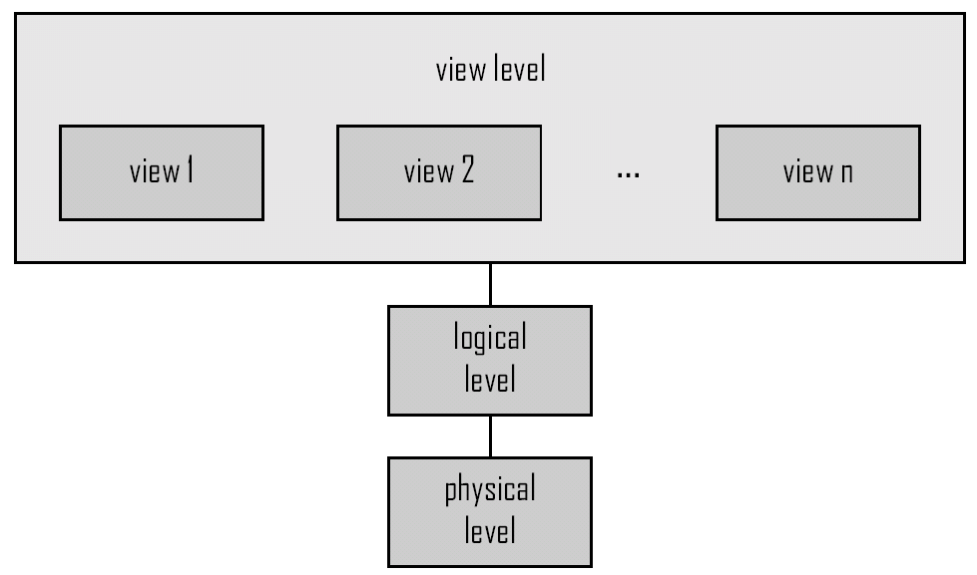
View of Data
An architecture for a database system
DBMS

Slide 8
Instances and Schemas
■
Similar to types and variables in programming languages
■
Schema – the logical structure of the database
●
Example: The database consists of information about a set of customers and
accounts and the relationship between them)
●
Analogous to type information of a variable in a program
●
Physical schema: database design at the physical level
●
Logical schema: database design at the logical level
■
Instance – the actual content of the database at a particular point in time
●
Analogous to the value of a variable
■
Physical Data Independence – the ability to modify the physical schema without changing the logical schema
●
Applications depend on the logical schema
●
In general, the interfaces between the various levels and components should be
well defined so that changes in some parts do not seriously influence others.
DBMS

Slide 9
Data Models
■
A collection of tools for describing
●
Data
●
Data relationships
●
Data semantics
●
Data constraints
■
Relational model
■
Entity-Relationship data model (mainly for database design)
■
Object-based data models (Object-oriented and Object-relational)
■
Semistructured data model (XML)
■
Other older models:
●
Network model
●
Hierarchical model
DBMS

Slide 10
Data Manipulation Language (DML)
■
Language for accessing and manipulating the data organized by the
appropriate data model
●
DML also known as query language
■
Two classes of languages
●
Procedural – user specifies what data is required and how to get
those data
●
Declarative (nonprocedural) – user specifies what data is
required without specifying how to get those data
■
SQL is the most widely used query language
DBMS

Slide 11
Data Definition Language (DDL)
■
Specification notation for defining the database schema
Example:
create table account (
account-number char(10),
balance integer)
■
DDL compiler generates a set of tables stored in a data dictionary
■
Data dictionary contains metadata (i.e., data about data)
●
Database schema
●
Data storage and definition language
 Specifies the storage structure and access methods used
●
Integrity constraints
 Domain constraints
 Referential integrity (references constraint in SQL)
 Assertions
●
Authorization
DBMS

Slide 12
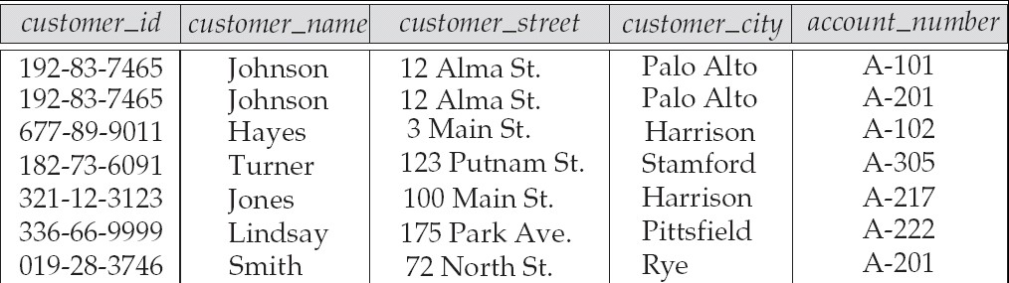
Relational Model
Attributes
■
Example of tabular data in the relational model
DBMS

Slide 13
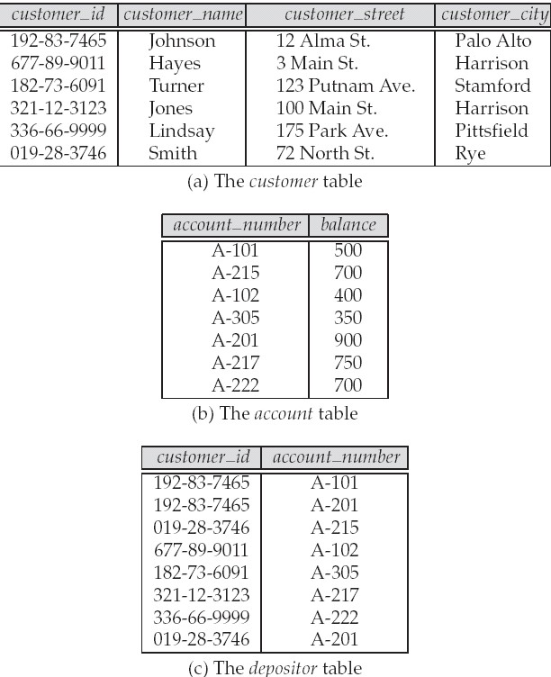
A Sample Relational Database
DBMS

Slide 14
SQL
■
SQL: widely used non-procedural language
●
Example: Find the name of the customer with customer-id 192-83-7465
select customer.customer_name
from customer
where customer.customer_id = ‘192-83-7465’
Example: Find the balances of all accounts held by the customer with
●
customer-id 192-83-7465 select account.balance from depositor, account
where depositor.customer_id = ‘192-83-7465’ and
depositor.account_number = account.account_number
■
Application programs generally access databases through one of
●
Language extensions to allow embedded SQL
●
Application program interface (e.g., ODBC/JDBC) which allow SQL
queries to be sent to a database
DBMS

Slide 15
Database Design
The process of designing the general structure of the database:
■
Logical Design – Deciding on the database schema. Database design
requires that we find a “good” collection of relation schemas.
●
Business decision – What attributes should we record in the
database?
●
Computer Science decision – What relation schemas should we
have and how should the attributes be distributed among the various relation schemas?
■
Physical Design – Deciding on the physical layout of the database

Slide 16
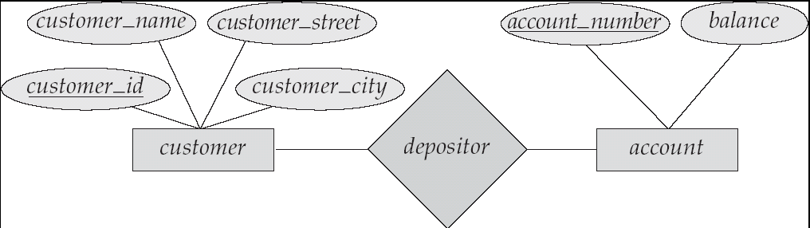
The Entity-Relationship Model
■
Models an enterprise as a collection of entities and relationships
●
Entity: a “thing” or “object” in the enterprise that is distinguishable
from other objects
 Described by a set of attributes
●
Relationship: an association among several entities
■
Represented diagrammatically by an entity-relationship diagram:
DBMS

Slide 17
Object-Relational Data Models
■
Extend the relational data model by including object orientation and
constructs to deal with added data types.
■
Allow attributes of tuples to have complex types, including non-atomic
values such as nested relations.
■
Preserve relational foundations, in particular the declarative access to
data, while extending modeling power.
■
Provide upward compatibility with existing relational languages.
DBMS

Slide 18
XML: Extensible Markup Language
■
Defined by the WWW Consortium (W3C)
■
Originally intended as a document markup language not a
database language
■
The ability to specify new tags, and to create nested tag structures
made XML a great way to exchange data, not just documents
■
XML has become the basis for all new generation data interchange
formats.
■
A wide variety of tools is available for parsing, browsing and
querying XML documents/data
DBMS

Slide 19
Storage Management
■
Storage manager is a program module that provides the interface
between the low-level data stored in the database and the application programs and queries submitted to the system.
■
The storage manager is responsible to the following tasks:
●
Interaction with the file manager
●
Efficient storing, retrieving and updating of data
■
Issues:
●
Storage access
●
File organization
●
Indexing and hashing
DBMS

Slide 20
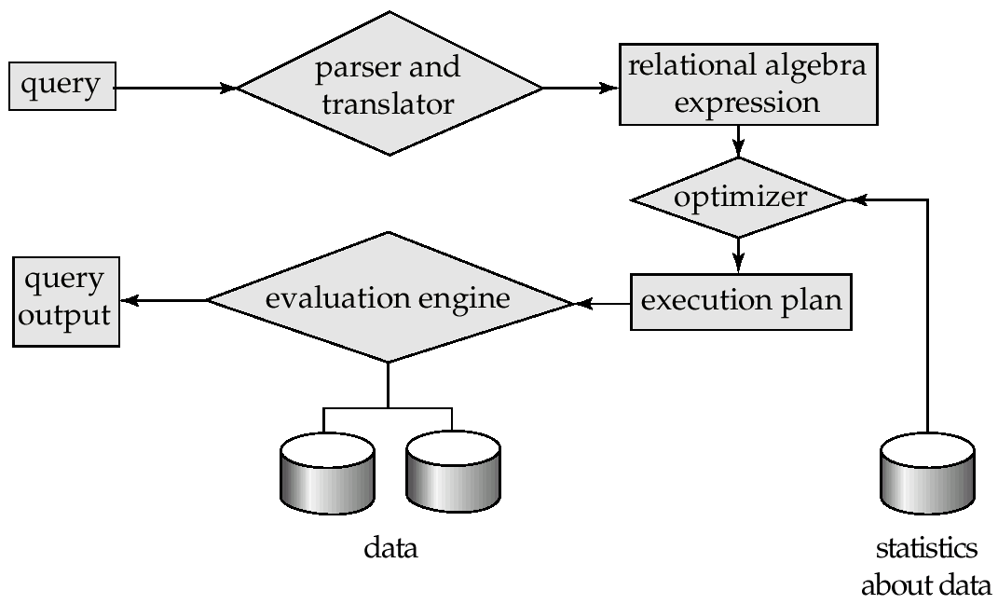
Query Processing
Parsing and translation
Optimization
Evaluation
DBMS

Slide 21
Query Processing (Cont.)
■
Alternative ways of evaluating a given query
●
Equivalent expressions
●
Different algorithms for each operation
■
Cost difference between a good and a bad way of evaluating a query can
be enormous
■
Need to estimate the cost of operations
●
Depends critically on statistical information about relations which the
database must maintain
●
Need to estimate statistics for intermediate results to compute cost of
complex expressions
DBMS

Slide 22
Transaction Management
■
A transaction is a collection of operations that performs a single
logical function in a database application
■
Transaction-management component ensures that the database
remains in a consistent (correct) state despite system failures (e.g., power failures and operating system crashes) and transaction failures.
■
Concurrency-control manager controls the interaction among the
concurrent transactions, to ensure the consistency of the database.
DBMS

Slide 23
Database Architecture
The architecture of a database systems is greatly influenced by the underlying computer system on which the database is running:
■
Centralized
■
Client-server
■
Parallel (multi-processor)
■
Distributed
DBMS

Slide 24
Database Users
Users are differentiated by the way they expect to interact with the system
■
Application programmers – interact with system through DML calls
■
Sophisticated users – form requests in a database query language
■
Specialized users – write specialized database applications that do
not fit into the traditional data processing framework
■
Naïve users – invoke one of the permanent application programs that
have been written previously
●
Examples, people accessing database over the web, bank tellers,
clerical staff
DBMS

Slide 25
Database Administrator
■
Coordinates all the activities of the database system; the
database administrator has a good understanding of the enterprise’s information resources and needs.
■
Database administrator's duties include:
●
Schema definition
●
Storage structure and access method definition
●
Schema and physical organization modification
●
Granting user authority to access the database
●
Specifying integrity constraints
●
●
Monitoring performance and responding to changes in
requirements
DBMS

Slide 26
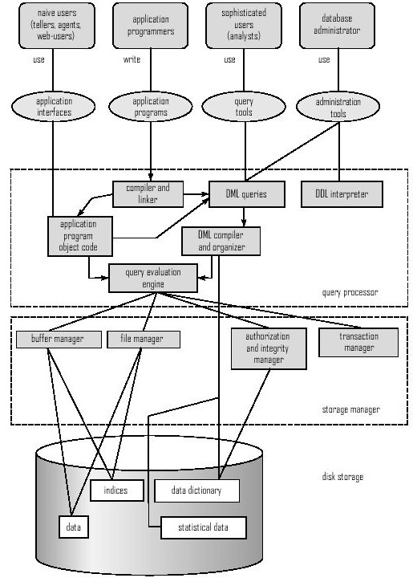
Overall System Structure
DBMS

